Slide 1


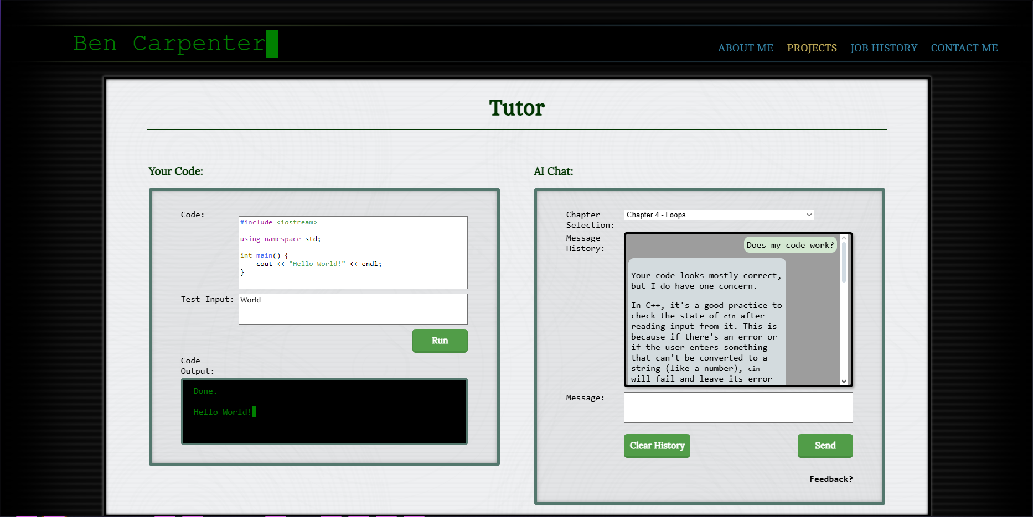
Generative Learning and AI:
Using Retrieval-Augmented Generation for C++ Tutoring
Ben Carpenter (Computer Science), James Stevens (Computer Science)
Advisor: Professor Hao Loi (Computer Science)
Introduction
The goal of our project was to design and implement an AI tutor for an introductory C++ programming course
We utilized a RAG method to provide an effective framework for learning
The responses are drawn from a strict data pool. This framework ensures relevant, concise responses to user queries
We aim to eliminate the drawbacks of typical AI generation which includes hallucination
Retrieval-Augmented Generation (RAG)
Conclusion
An effective Python implementation that provides concise answers to user queries
A great tool for any beginning programmer in C++
Bulit as an API, the RAG framework allows for custom frontends
This algorithm enhances the performance of generative AI models
It begins with indexing of data from relevant sources/documents in a vector database
Next it retrieves the most accurate information based on a similarity search
Augmentation occurs when info is supplied to the LLM along with the user query
The generated response is created based on its knowledge and the supplied data
Systems Used
The backend is built in Python with ChromaDB and Ollama
We used llama 3.2 for our LLM
The user interface was made with JavaScript and HTML/CSS
Testing supplemented by XAMPP
Challenges
Our goal was to create an effective, concise RAG tutor for an introductory C++ course
Initial challenges included:
implementation in C++ itself
communication within the RAG pipeline
the lack of supported vector database libraries in C++ forced us to use a Python framework
Other challenges encountered:
how to generate the most accurate
responses based on the data files we supplied the RAG
how to minimize hallucination
inappropriate answers
Data Flow
Results
.
The chat tutor is fully-functional and will answer students’ queries, generating accurate responses
The responses cite the section of the textbook that the information is retrieved from
The Python RAG pipeline is slightly more resource intensive than a C++ build, but is still effective and developer-friendly
Anyone can host the API and tailor it to their needs
Methodology
We utilized text from ZyBooks as our data files
The textbook provided updated, accurate information to supplement the LLM in response to user queries
We began implementing the tutor by communicating with the LLM and then integrating the RAG system
Backend is an API so anyone can attach a front-end of their preference

